Slide 1
Machine Learning
Lecture 18b: Random Forest / Boosting
Dr. Beilun Wang
Southeast University
School of Computer Science
and Engineering

Slide 2
Course Content Plan
Regression (supervised)
Classification (supervised)
Unsupervised models
Learning theory
Y is a continuous
Y is a discrete
NO Y
About f()
Graphical models
About interactions among X1,… Xp
Reinforcement Learning
Learn program to Interact with its environment

Slide 3
Three major sections for classification
We can divide the large variety of classification approaches into roughly three major types
Discriminative
directly estimate a decision rule/boundary
e.g., support vector machine, decision tree, logistic regression, e.g. neural networks (NN), deep NN
Generative:
build a generative statistical model
e.g., Bayesian networks, Naïve Bayes classifier
Instance based classifiers
Use observation directly (no models)
e.g. K nearest neighbors

Slide 4

Today: Ensemble

Slide 5
Today: Ensemble
Framework of Ensemble:
Get a set of classifiers 𝑓₁(𝑥),𝑓₂(𝑥),𝑓₃(𝑥)…They should be diverse.
Aggregate the classifiers (properly)
For example
How to have different training data sets
Re-sampling your training data to form a new set
Re-weighting your training data to form a new set

Slide 6
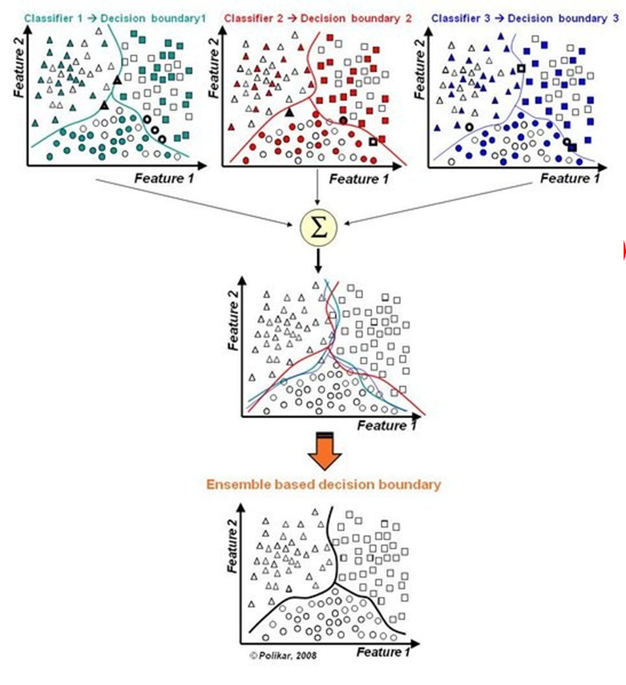

Slide 7
Today: Ensemble
Bagging
Bagged Decision Tree
Random forests
Stacking
Boosting
Adaboost
Xgboost

Slide 8
Bagging
Bagging or bootstrap aggregation
a technique for reducing the variance of an estimated prediction function.
For instance, for classification, a committee of decision trees
Each tree casts a vote for the predicted class.

Slide 9
Bootstrap
The basic idea:
randomly draw datasets with replacement (i.e. allows duplicates) from the training data, each samples the same size as the original training set

Slide 10
With vs Without Replacement
Bootstrap with replacement can keep the sampling size the same as the original size for every repeated sampling. The sampled data groups are independent on each other.
Bootstrap without replacement cannot keep the sampling size the same as the original size for every repeated sampling. The sampled data groups are dependent on each other.

Slide 11
Bagging
Create bootstrap samples from the training data
M features
N
N examples
N
N
....…
N

Slide 12
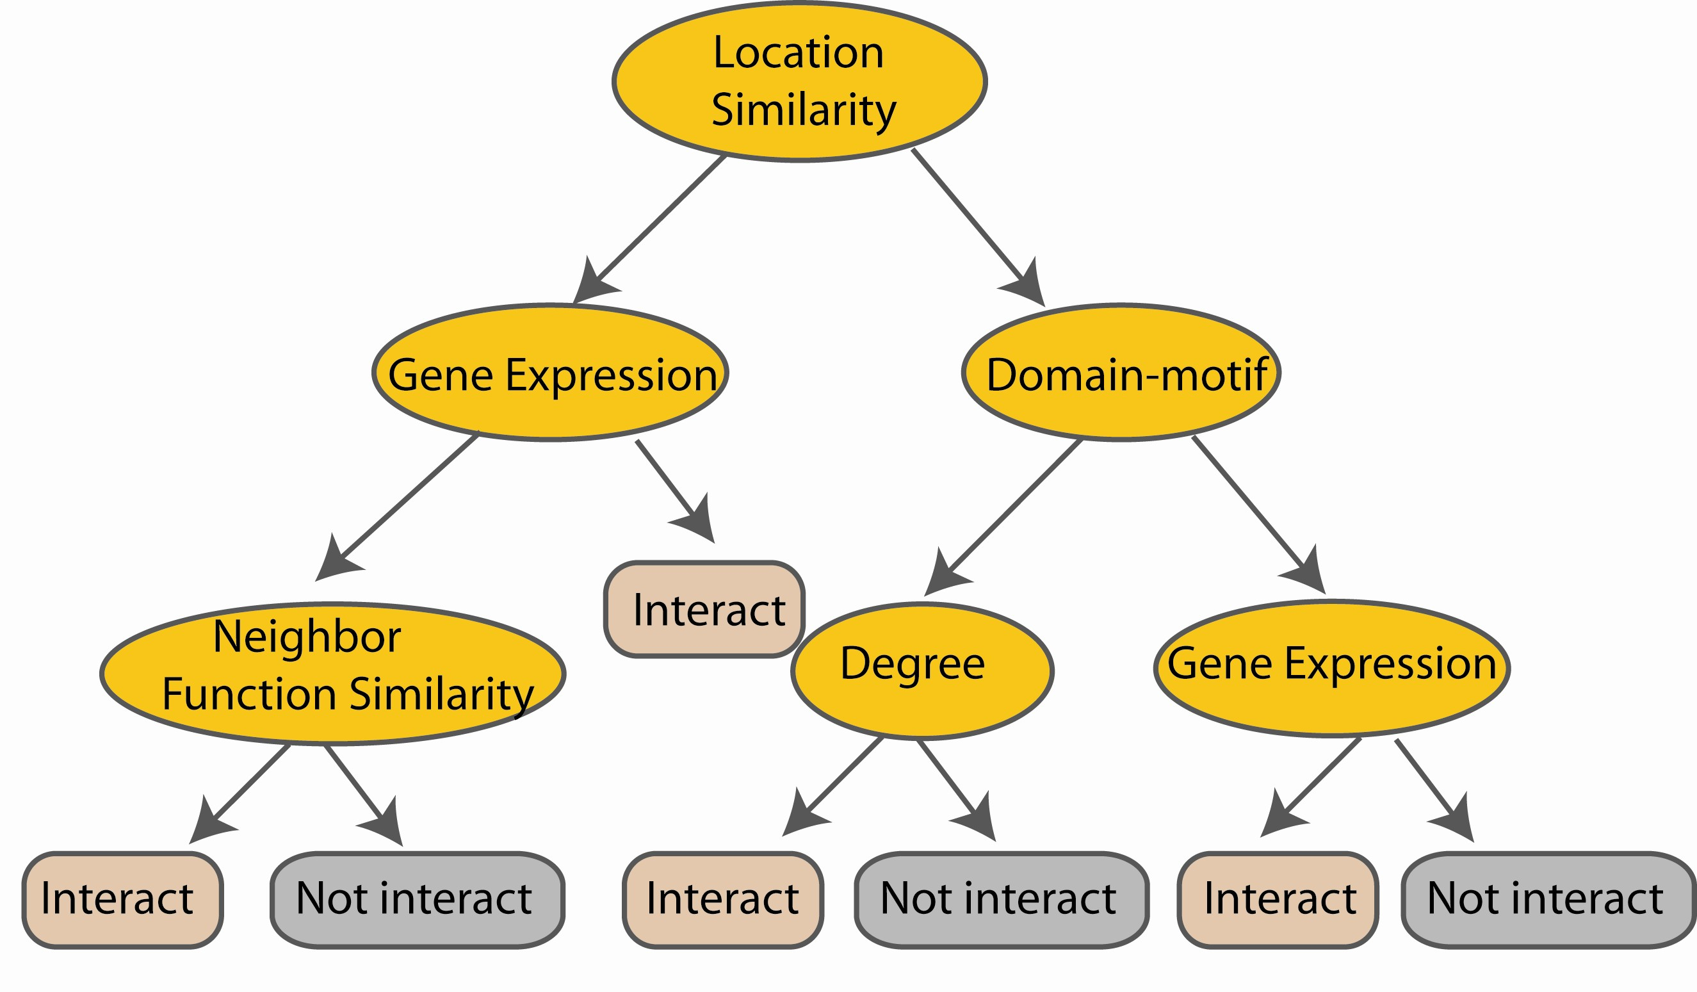
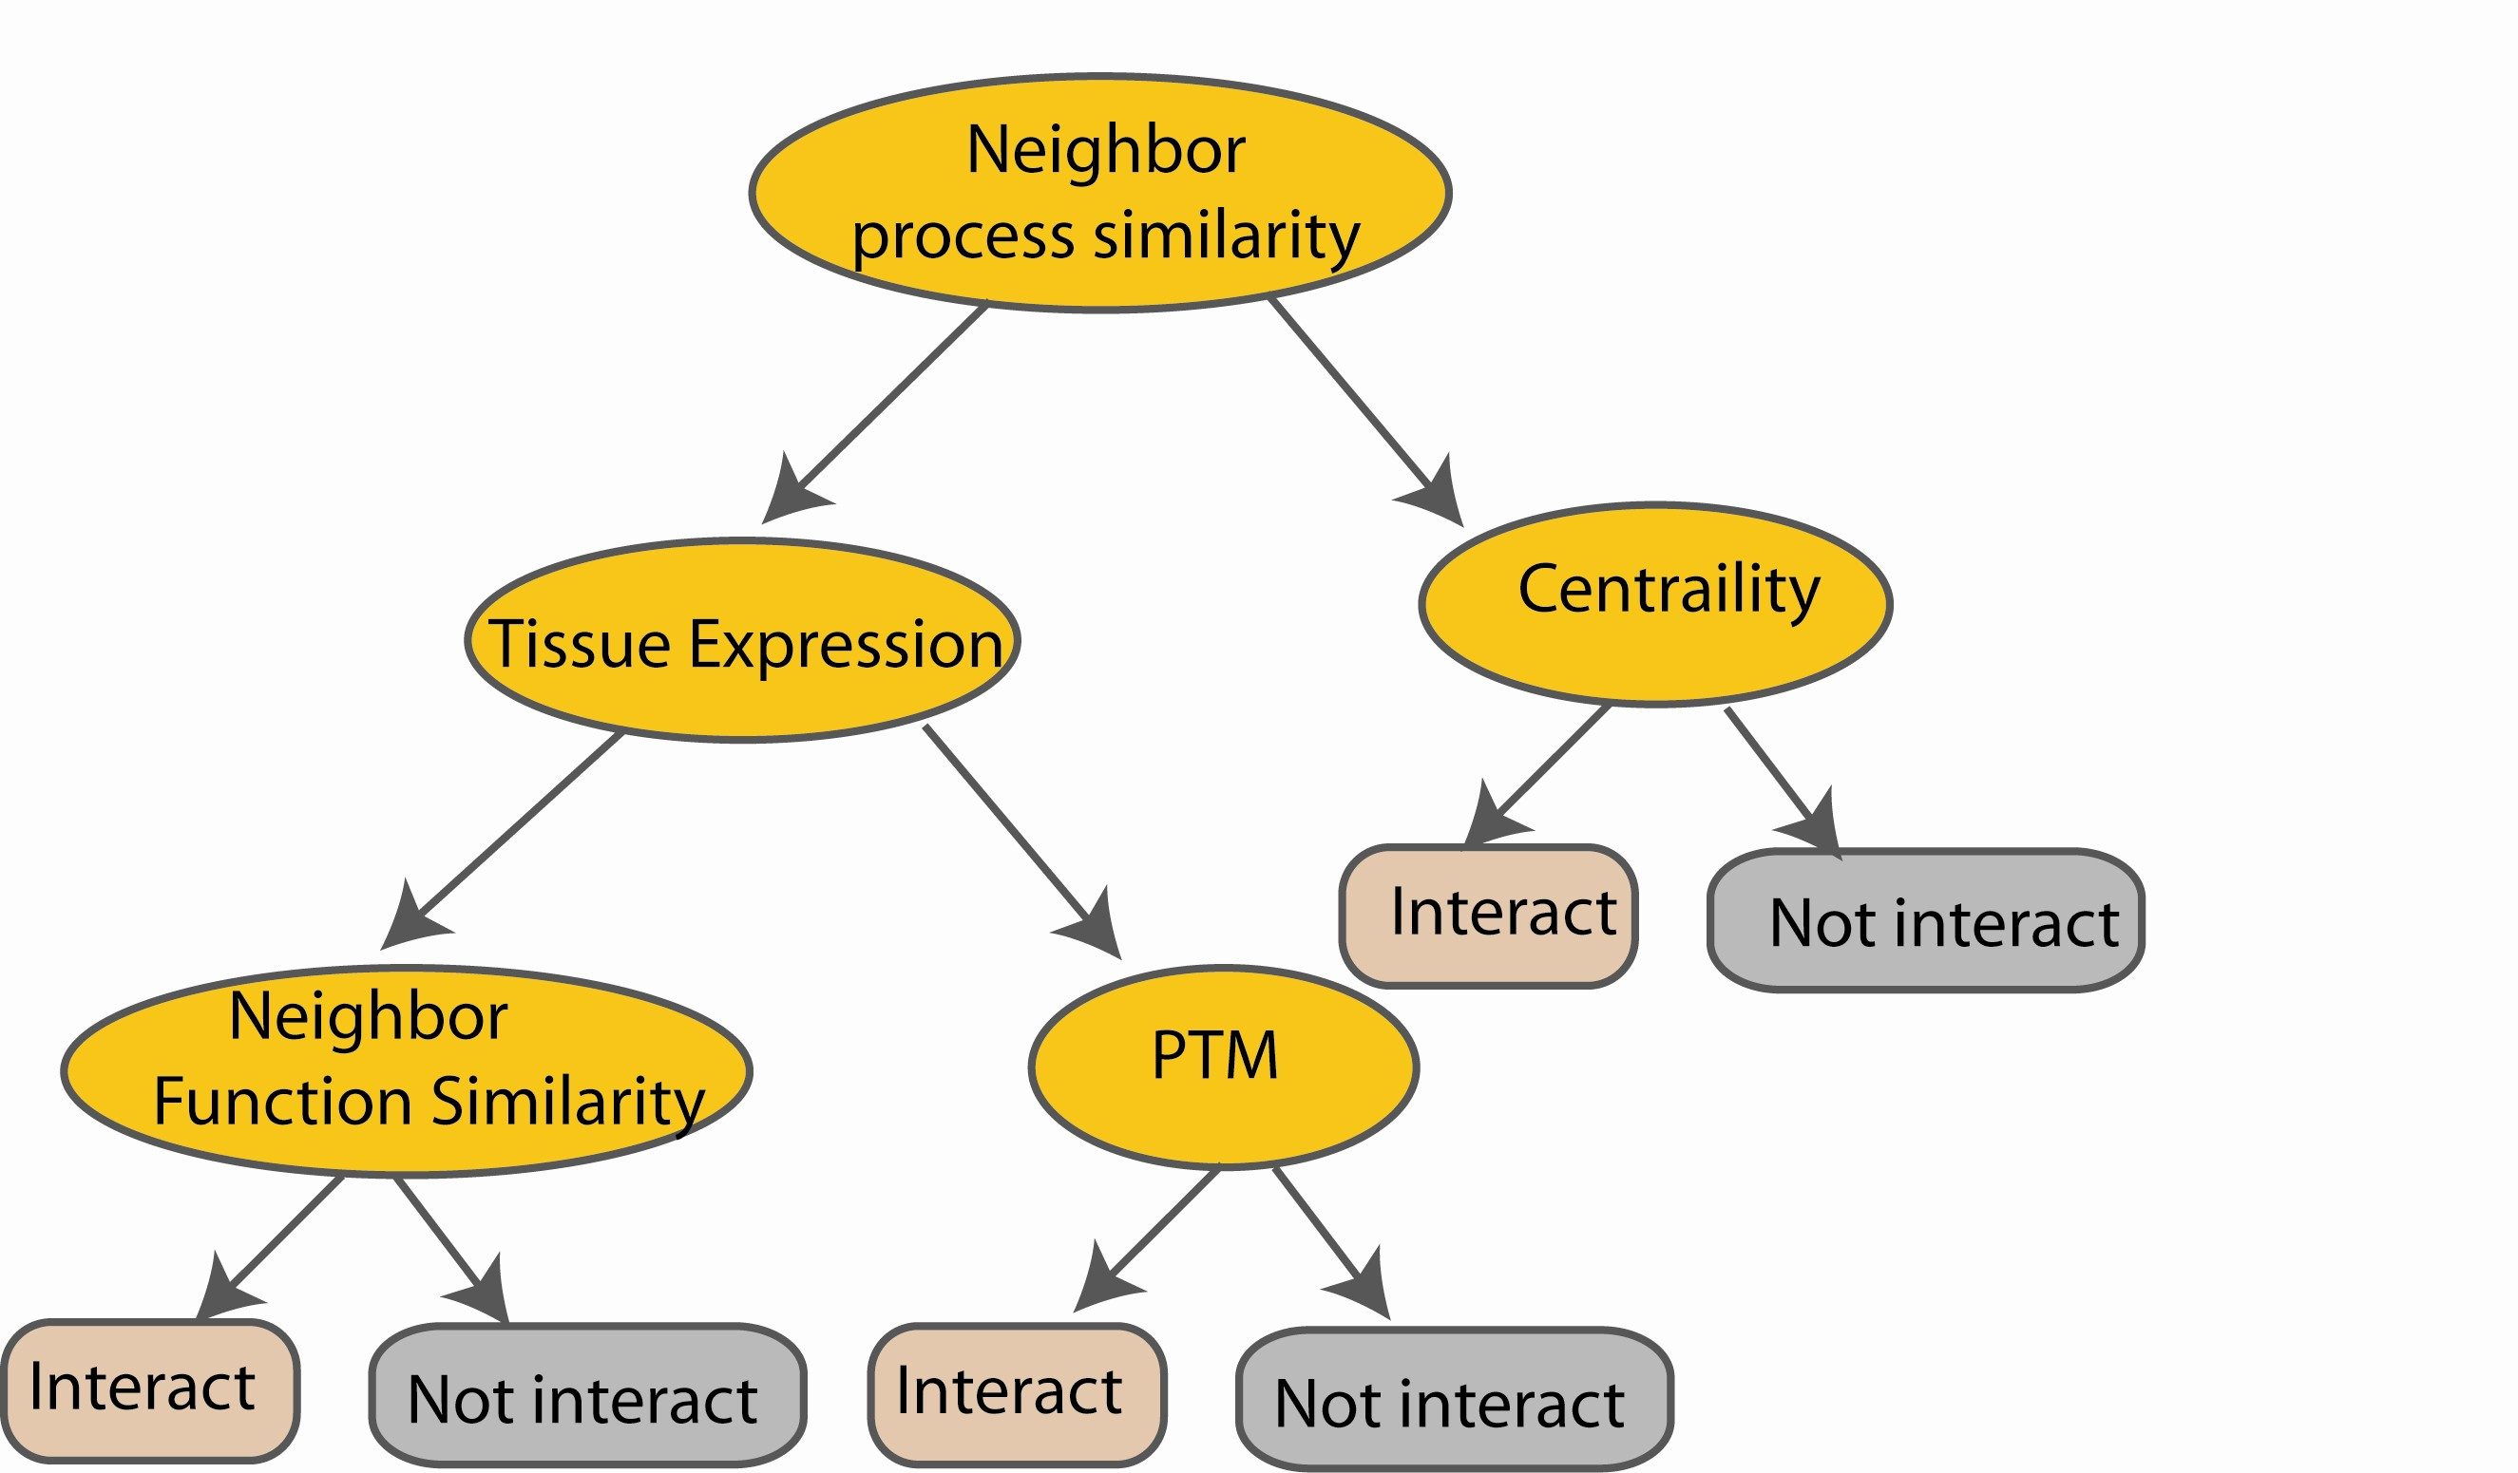
Bagging of DT Classifiers
e.g.
M features
N examples
Take the majority vote
i.e. Refit the model to each bootstrap dataset, and then examine the behavior over the B replications.
....…
....…

Slide 13
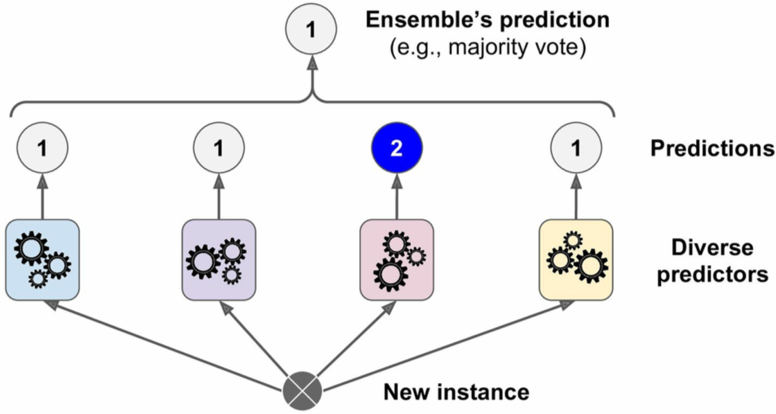
E.g. Predict by Hard voting

Slide 14
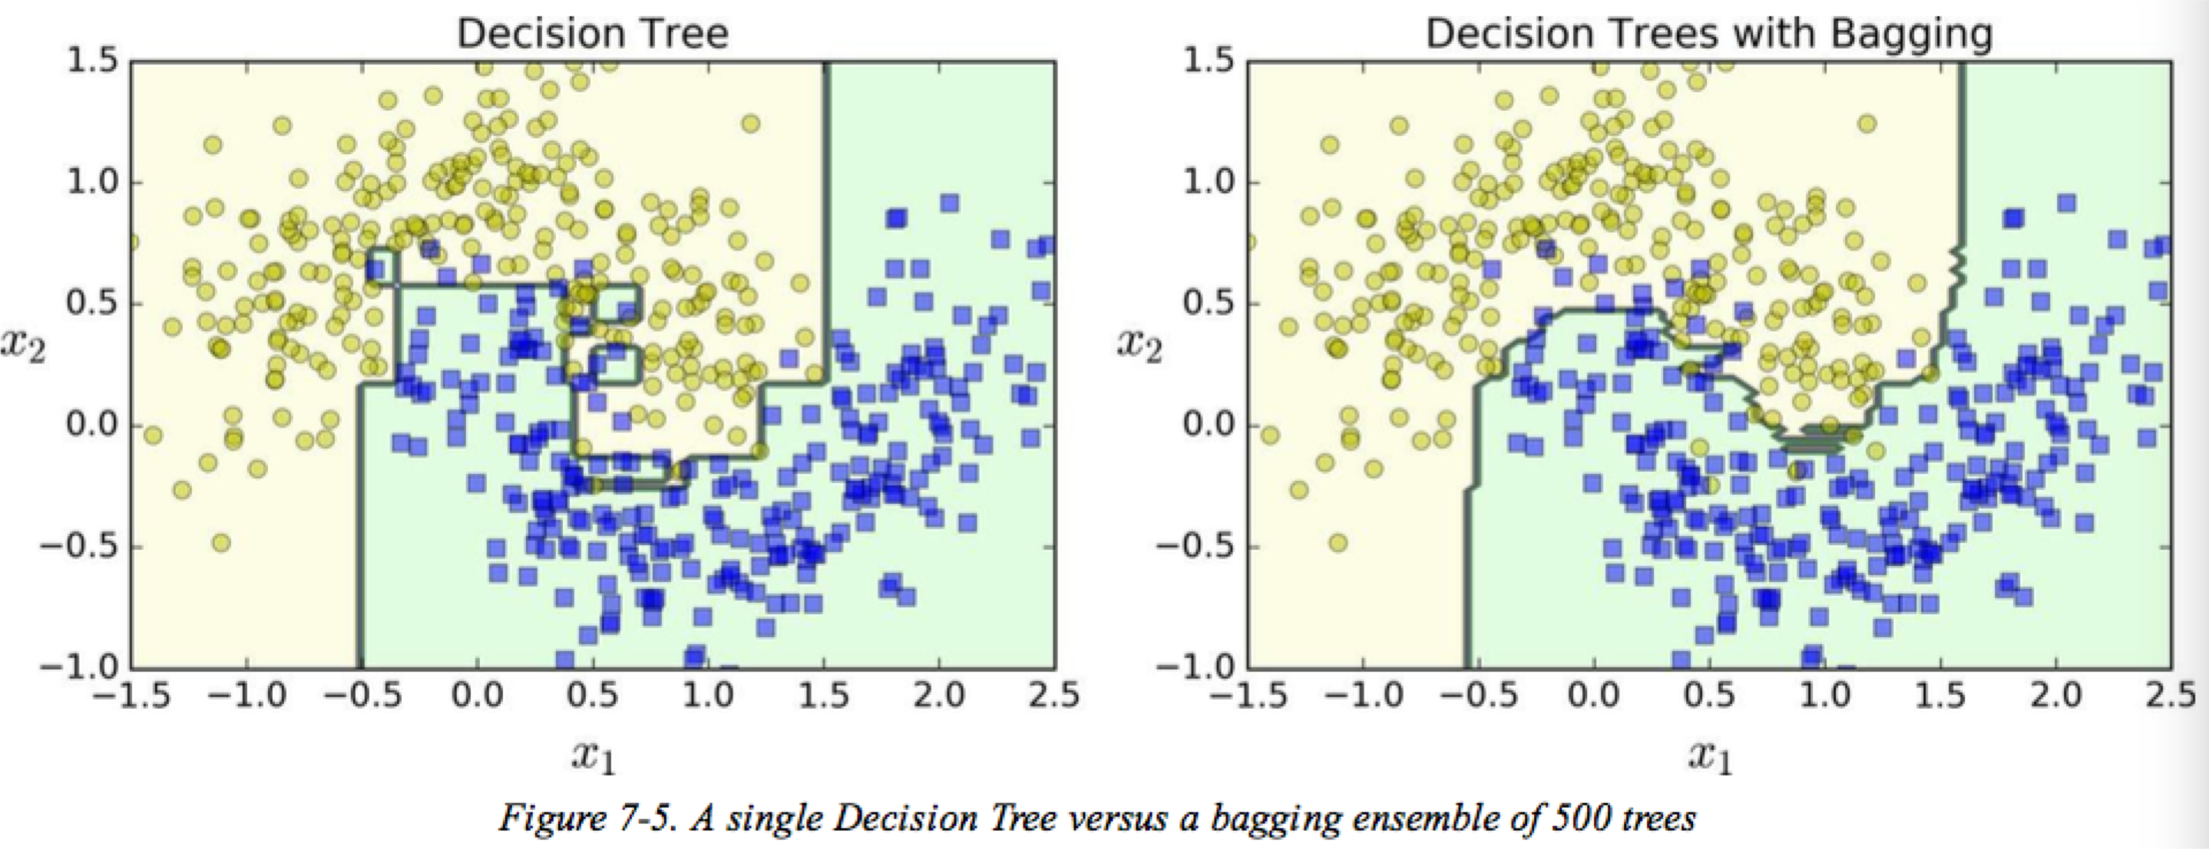
Decision Boundary Comparison

Slide 15
Peculiarities of Bagging
Model Instability is good when bagging
The more variable (unstable) the basic model is, the more improvement can potentially be obtained
Low-variability methods (e.g. LDA) improve less than High-variability methods (e.g. decision trees)

Slide 16
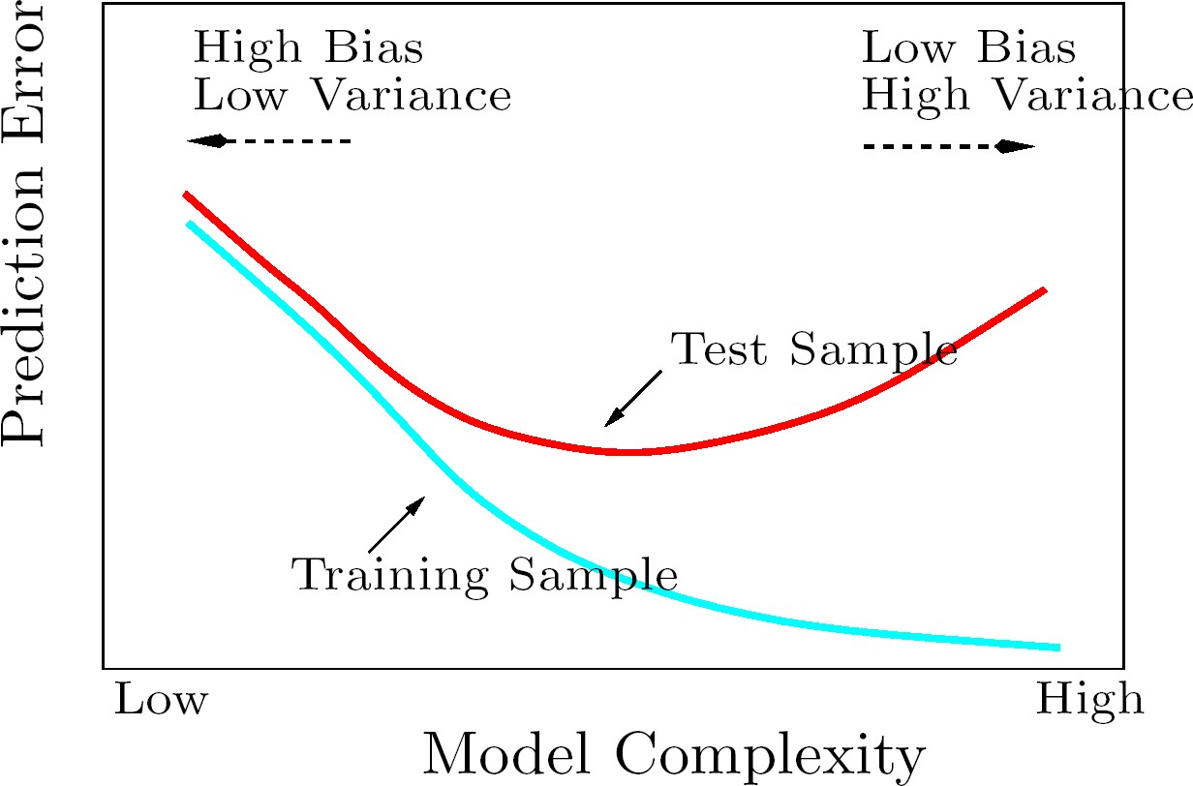
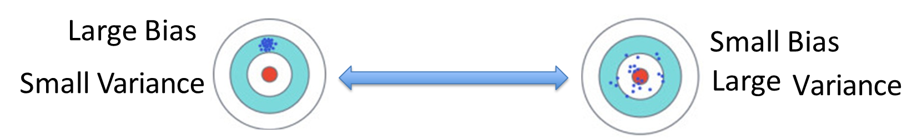
Recap: Bias-Variance Tradeoff / Model Selection
underfit region
overfit region

Slide 17
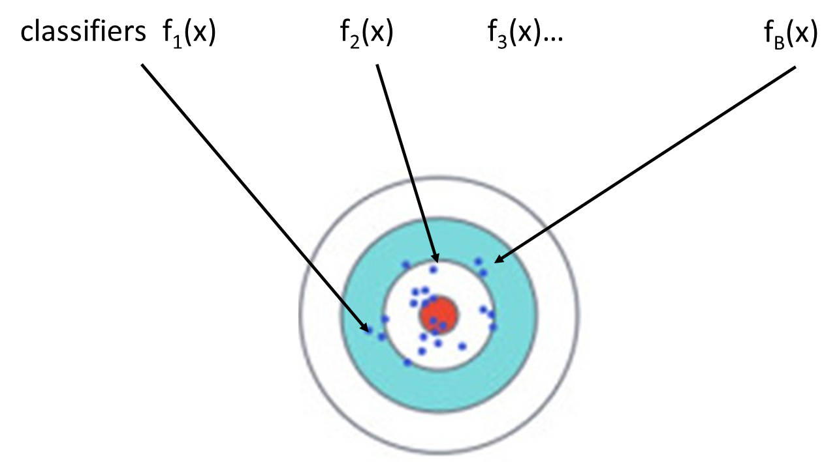
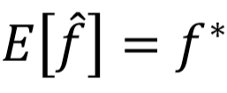
Recap: Bias-Variance Tradeoff / Model Selection
A complex model will have large variance. We can average complex models to reduce variance.
If we average all the 𝑓₁ , is it close to𝑓*

Slide 18
Bagging: an example with simulated data
N = 30 training samples,
two classes and p = 5 features,
Each feature N(0, 1) distribution and pairwise correlation .95 Response Y generated according to:
Test sample size of 2000
Fit classification trees to training set and bootstrap samples
B = 200

Slide 19
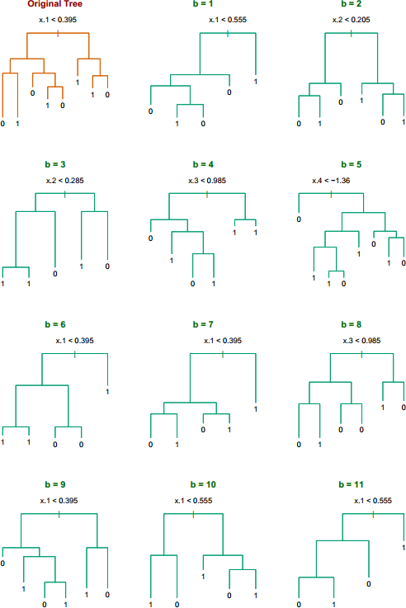
Five features highly correlated with each other
Notice the bootstrap trees are different than the original tree
→ No clear difference with picking up which feature to split
→ Small
changes in the training set will result in different tree
→ But these trees are actually quite similar for classification

Slide 20
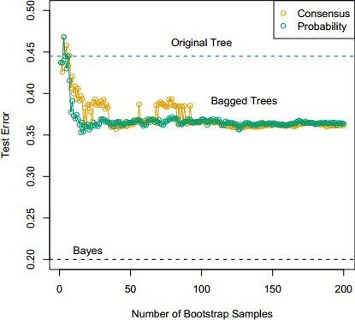
→ For B>30, more trees do not improve the bagging results
→ Since the trees correlate highly to each other and give similar classifications
Consensus: Majority vote
Probability: Average distribution at terminal nodes

Slide 21
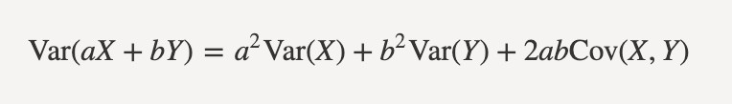
Bagging
Slightly increases model complexity
Cannot help when greater enlargement of model diversity is needed
Bagged trees are correlated
Use random forest to reduce correlation between trees

Slide 22
Today: Ensemble
Bagging
Bagged Decision Tree
Random forests
Stacking
Boosting
Adaboost
Xgboost

Slide 23
Random forest classifier
Random forest classifier
an extension to bagging
which uses de-correlated trees.

Slide 24
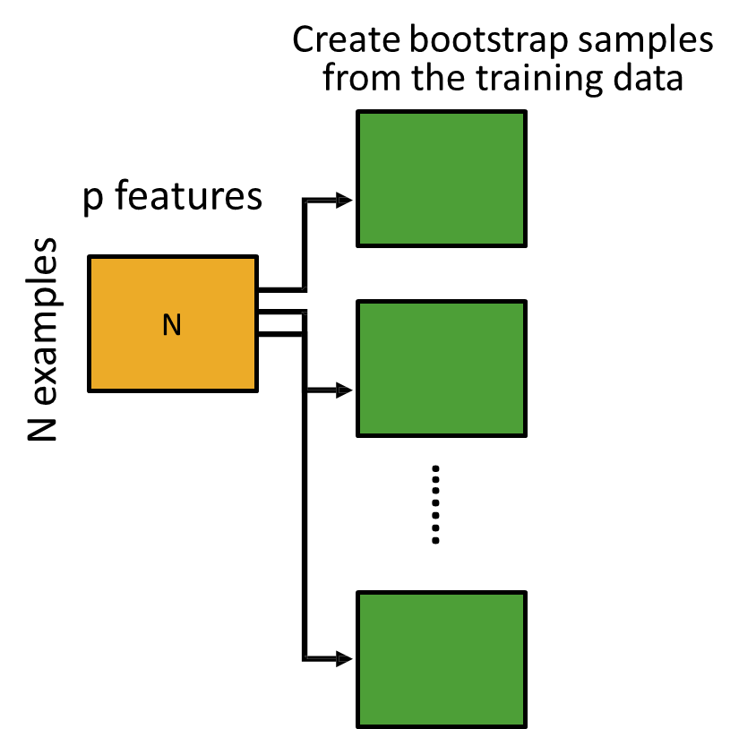
Random Forest Classifier

Slide 25
Random Forest Classifier
At each node when choosing the split feature choose only among m<p features

Slide 26
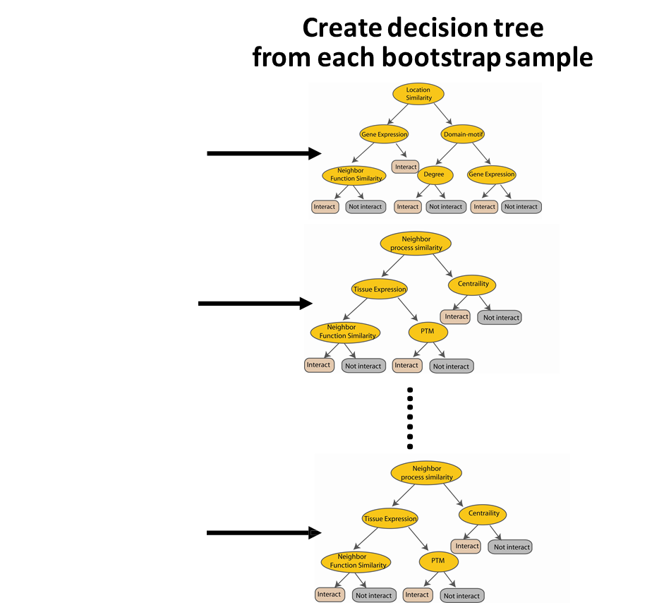
Random Forest Classifier
Take the majority vote

Slide 27
Random Forests
For each of our B bootstrap samples
Form a tree in the following manner
i: Given p dimensions, pick m of them
ii: Split only according to these m dimensions
(we will NOT consider the other p-m dimensions)
Repeat the above steps i & ii for each split
Note: we pick a different set of m dimensions for each split on a single tree

Slide 28
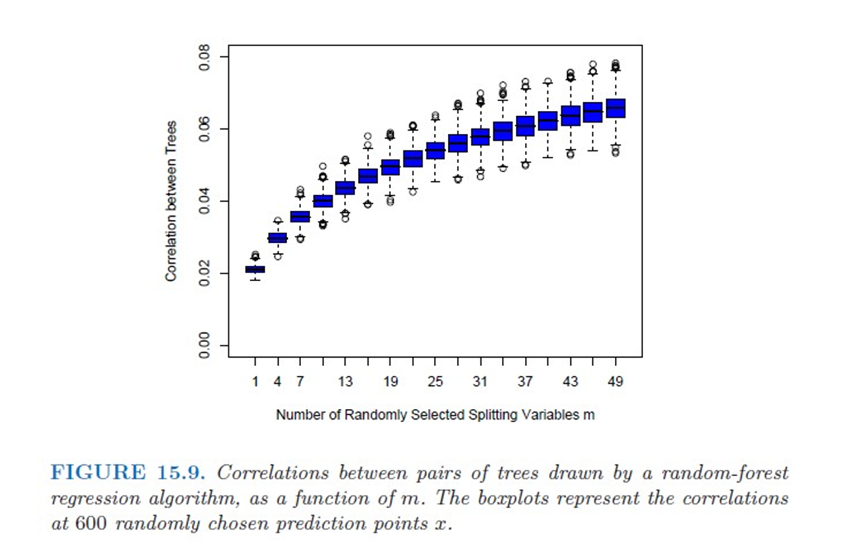

Slide 29
Random Forests
Random forest can be viewed as a refinement of bagging with a tweak of decorrelating the trees:
At each tree split, a random subset of m features out of all p features is drawn to be considered for splitting
Some guidelines provided by Breiman, but be careful to choose m based on specific problem:
m = p amounts to bagging
m = p/3 or log2(p) for regression
m = sqrt(p) for classification

Slide 30
Why correlated trees are not ideal?
Random Forests try to reduce correlation between the trees.
Why?

Slide 31
Why correlated trees are not ideal?
Assuming each tree has variance σ²
If trees are independently identically distributed, then average variance is σ²/B

Slide 32
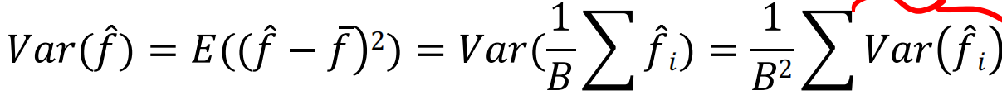
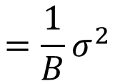
$$=\frac{1}{B}σ^{2}$$
A complex model will have large variance. We can average complex models to reduce variance.
If we average all the 𝑓₁ , is it close to𝑓*

Slide 33
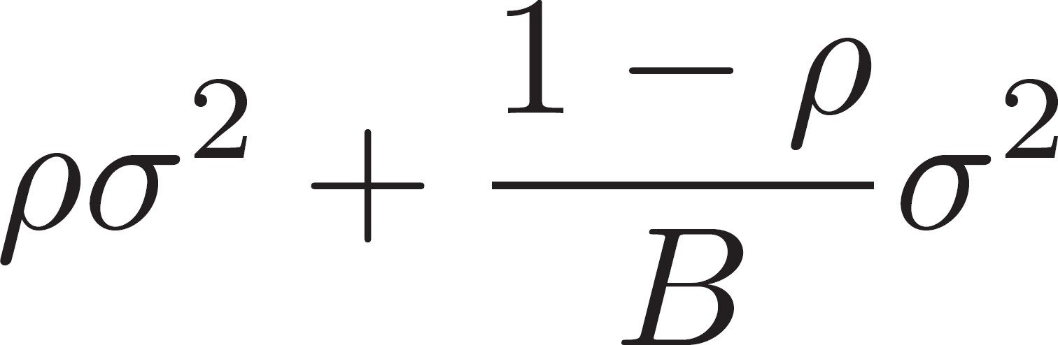
Why correlated trees are not ideal?
Assuming each tree has variance σ²
If simply identically distributed, then average variance is
As B → ∞, second term → 0
Thus, the pairwise correlation always affects the variance

Slide 34
Why correlated trees are not ideal?
How to deal?
If we reduce m (the number of dimensions we actually consider in each splitting), then we reduce the pairwise tree correlation
Thus, variance will be reduced.

Slide 35
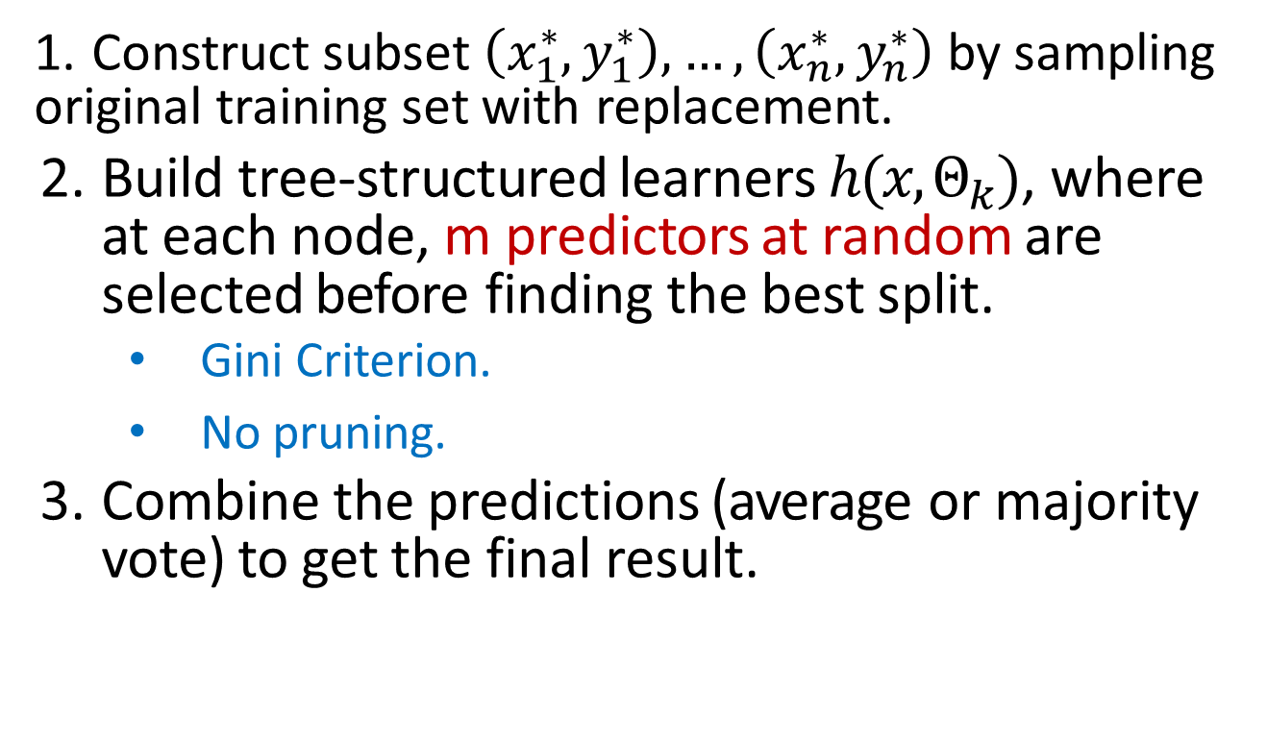
More about Random Forests
1. Construct subset $\left(x_{1}^{∗},y_{1}^{∗}\right),…,\left(x_{n}^{∗},y_{n}^{∗}\right)$ by sampling original training set with replacement.
Build tree-structured learners $h(x,Θ_{k})$, where at each node, m predictors at random are selected before finding the best split.
Gini Criterion.
No pruning.
Combine the predictions (average or majority vote) to get the final result.

Slide 36
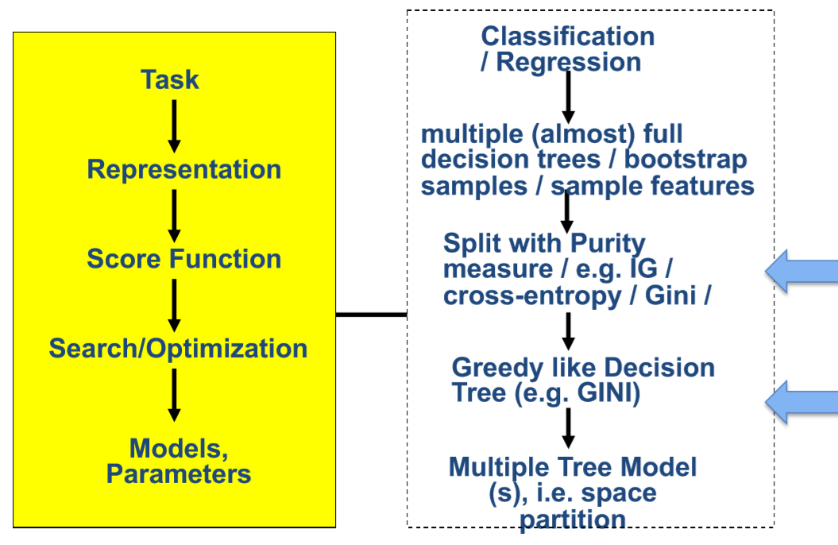
Random forest

Slide 37
Today: Ensemble
Bagging
Bagged Decision Tree
Random forests
Stacking
Boosting
Adaboost
Xgboost

Slide 38
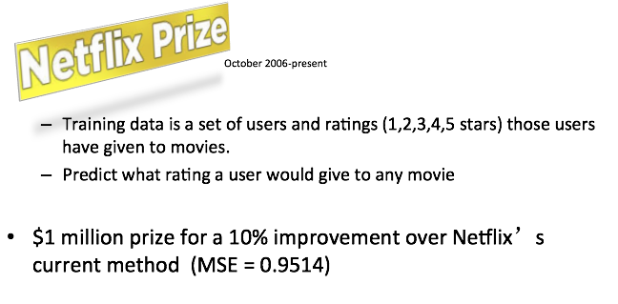
e.g. Ensembles in practice
Each rating/sample:
+ <user, movie, date of grade, grade>
Training set (100,480,507 ratings) Qualifying set (2,817,131 ratings)➔ winner

Slide 39
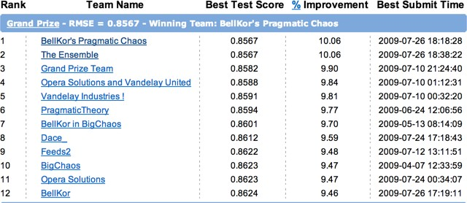
Ensemble in practice
Team “Bellkor's Pragmatic Chaos” defeated the team “ensemble” by submitting just 20 minutes earlier! → 1 million dollar!
The ensemble team → blenders of multiple different methods

Slide 40
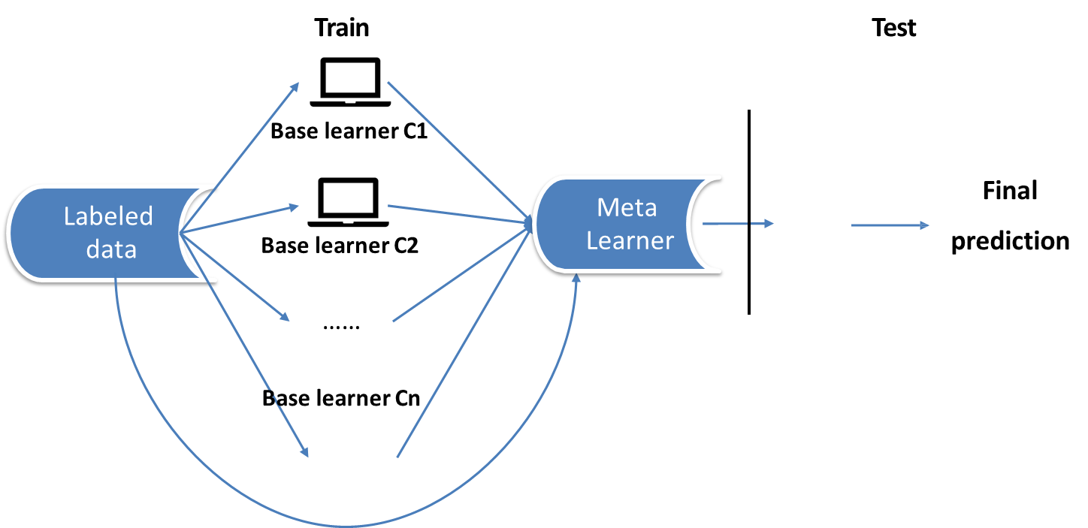


Stacking
Main Idea: Learn and combine multiple classifiers

Slide 41

Generating Base and Meta Learners
Base model—efficiency, accuracy and diversity
Sampling training examples
Sampling features
Using different learning models
Meta learner
Majority voting
Weighted averaging
…..
Higher level classifier — Supervised (e.g. Xgboost as blender)
Unsupervised

Slide 42
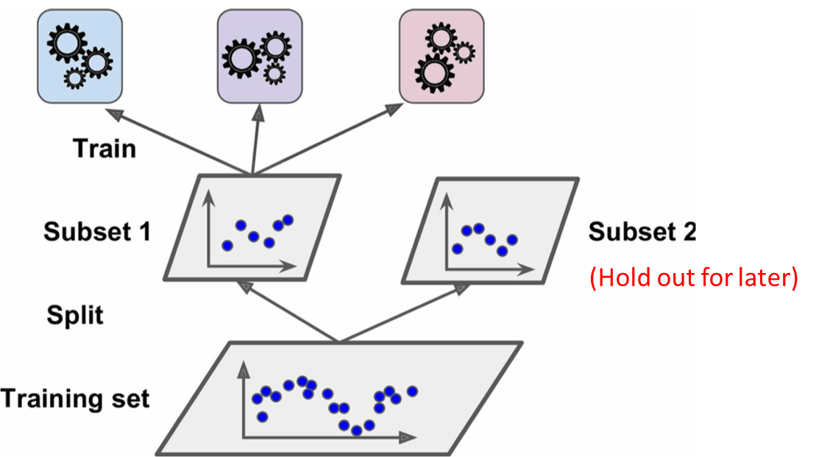
Training the base predictors

Slide 43
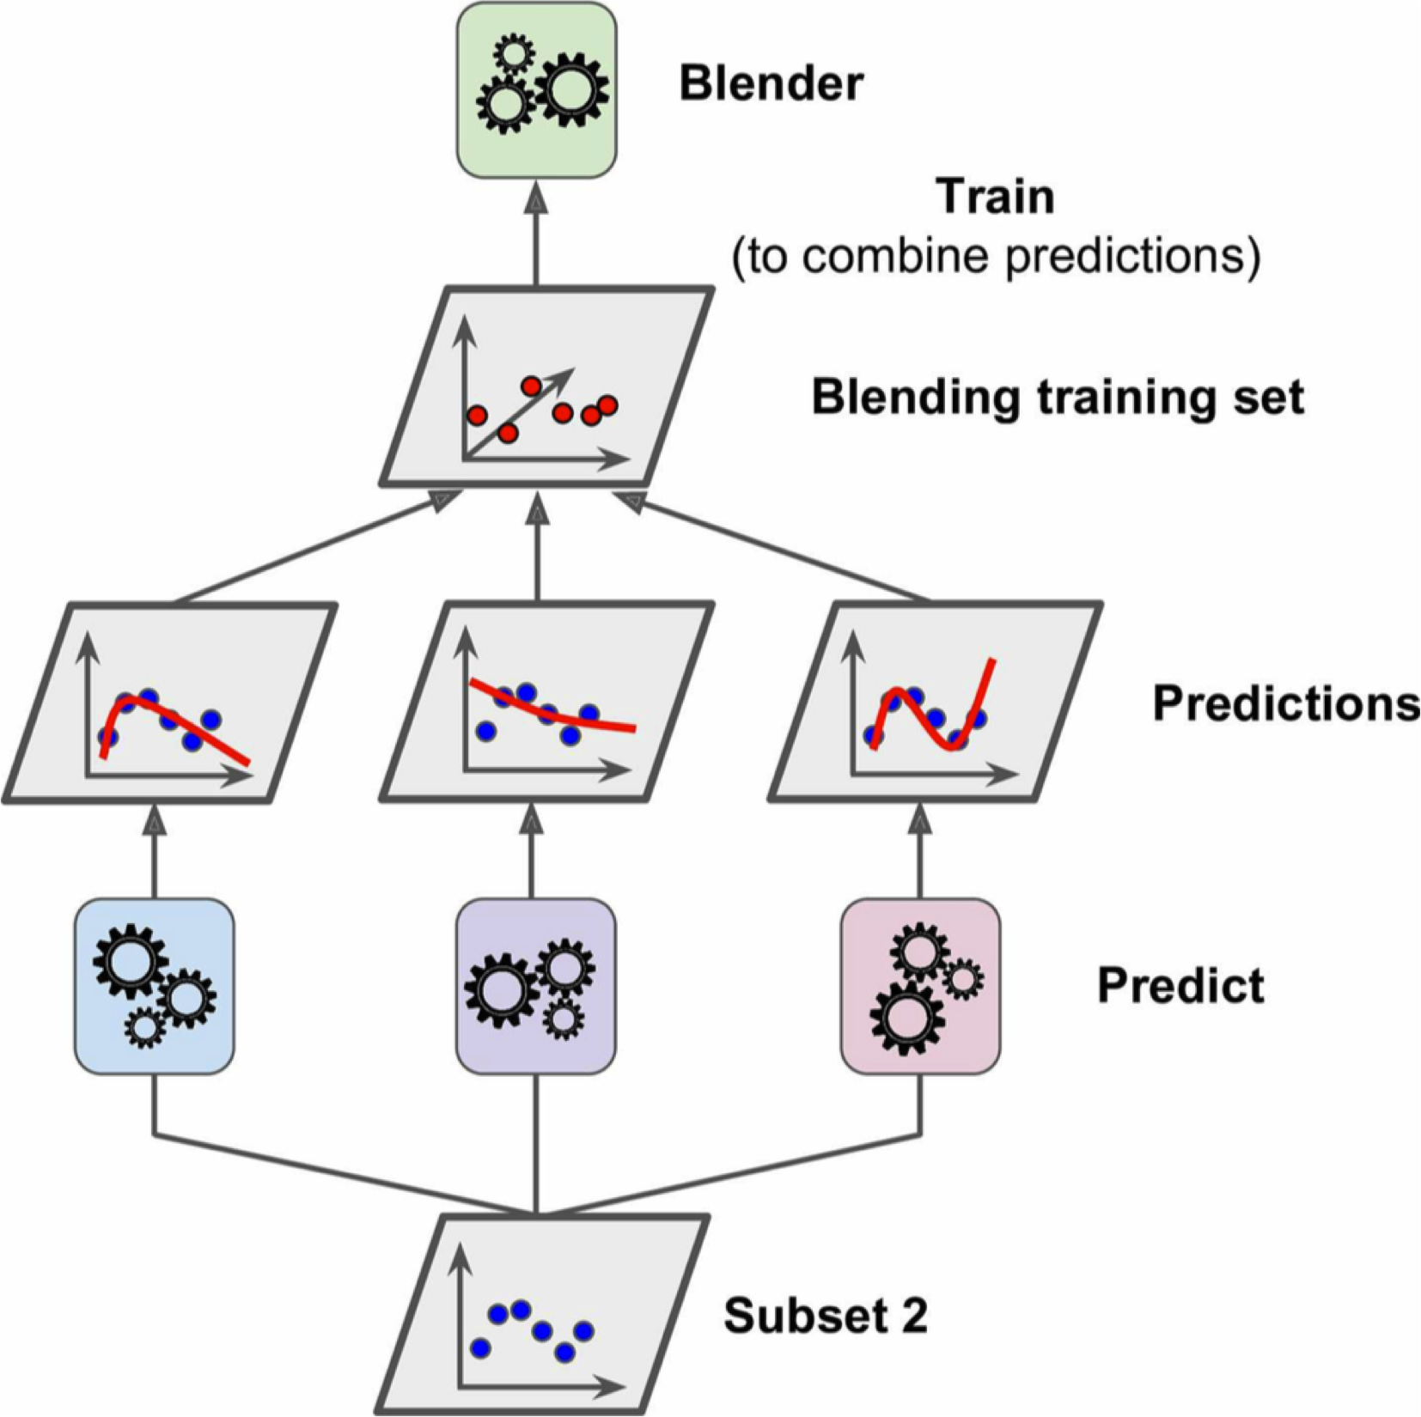
Training the meta blender

Slide 44
Today: Ensemble
Bagging
Bagged Decision Tree
Random forests:
Stacking
Boosting
Adaboost
Xgboost

Slide 45
Boosting Strategies
Have many rules (base classifiers) to vote on the decision
Sequentially train base classifiers that corrects mistakes of previous → focus on hard examples
Give higher weight to better rules

Slide 46
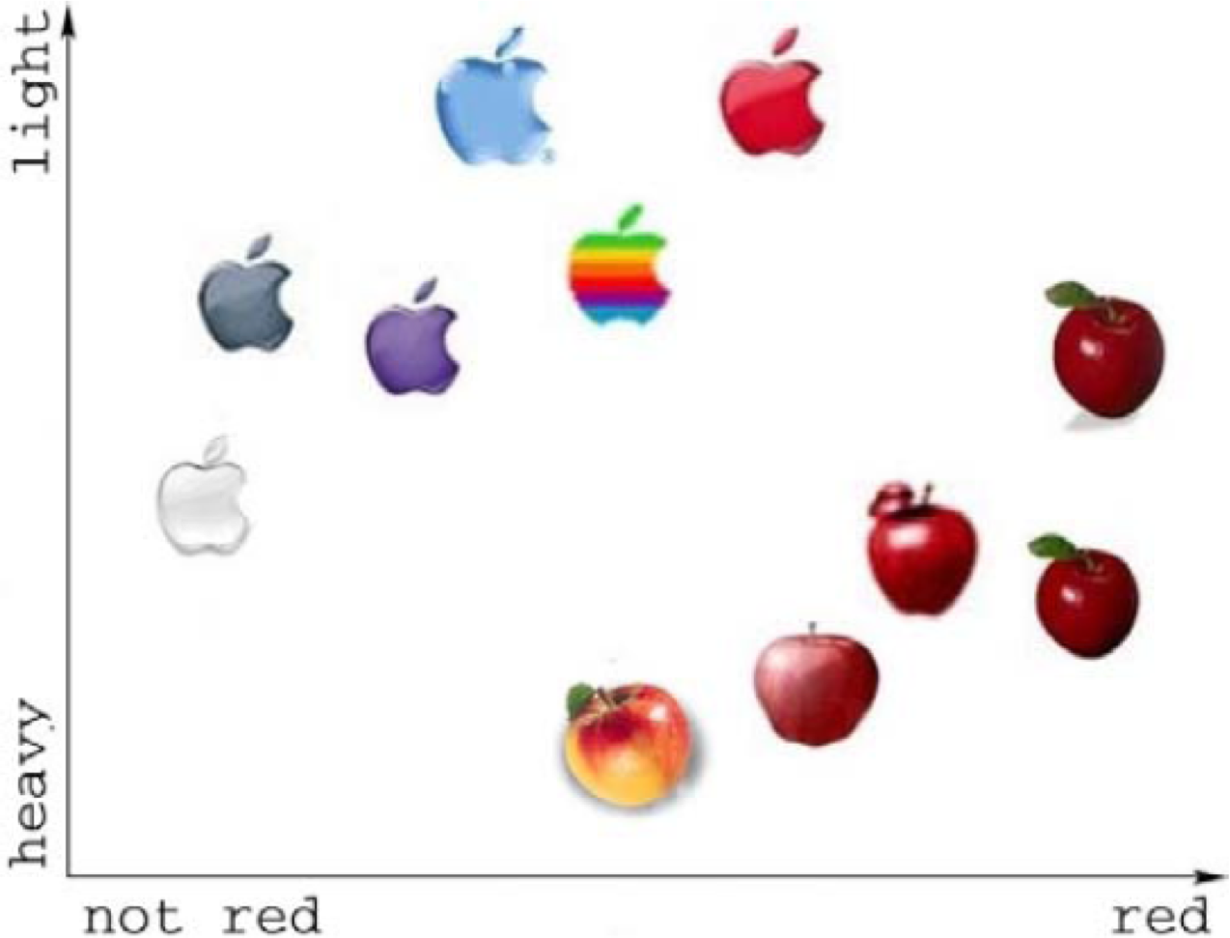
Recognizing apples:
(1) Collect a set of real apples and plastic apples
(2) Observe some rules to tell them apart based on their characteristics
X₂
X₁

Slide 47
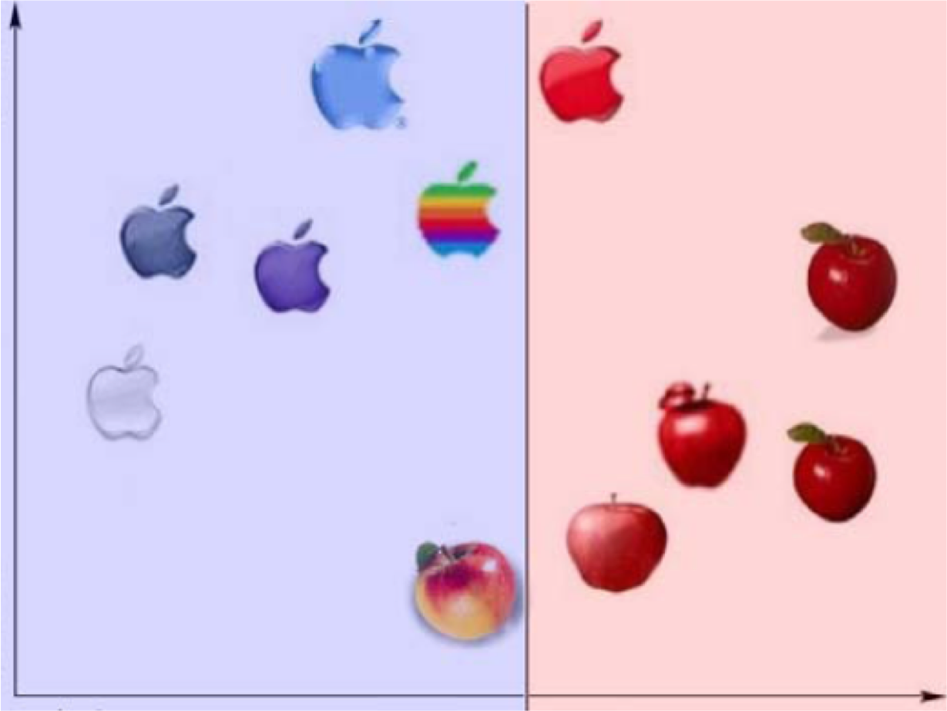
Have many rules (base classifiers) to vote on the decision
Sequentially train base classifiers that corrects mistakes of previous → focus on hard examples
Give higher weight to better rules
1st Simple Rule

Slide 48
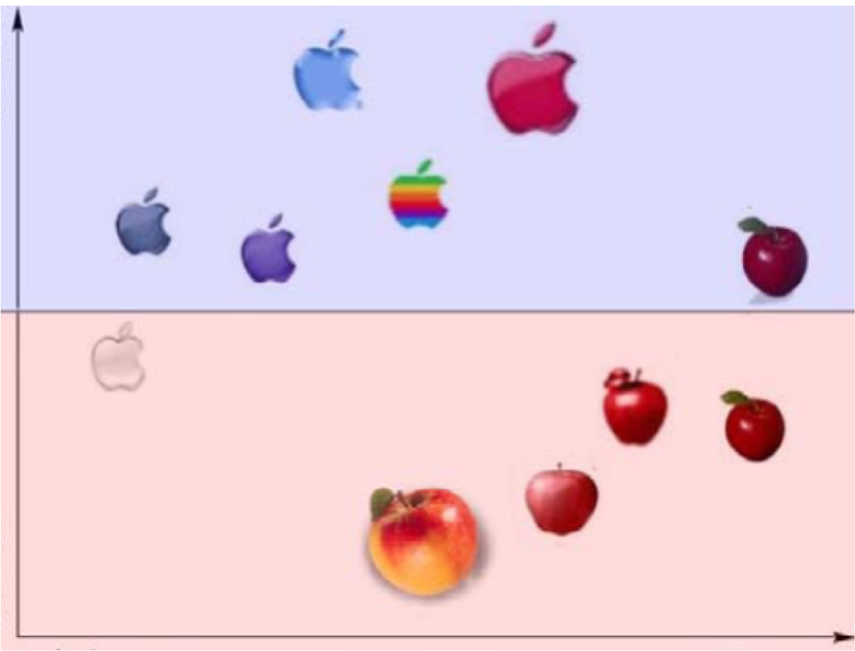
Have many rules (base classifiers) to vote on the decision
Sequentially train base classifiers that corrects mistakes of previous → focus on hard examples
Give higher weight to better rules
2nd Rule

Slide 49
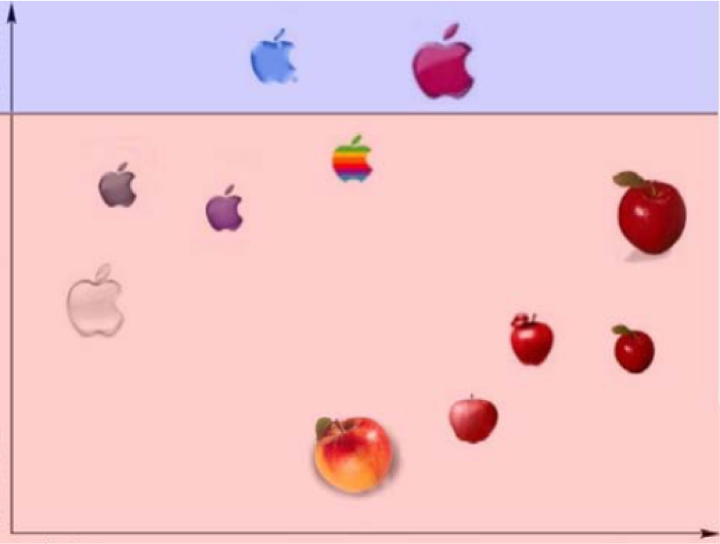
Have many rules (base classifiers) to vote on the decision
Sequentially train base classifiers that corrects mistakes of previous → focus on hard examples
Give higher weight to better rules
3rd Rule

Slide 50
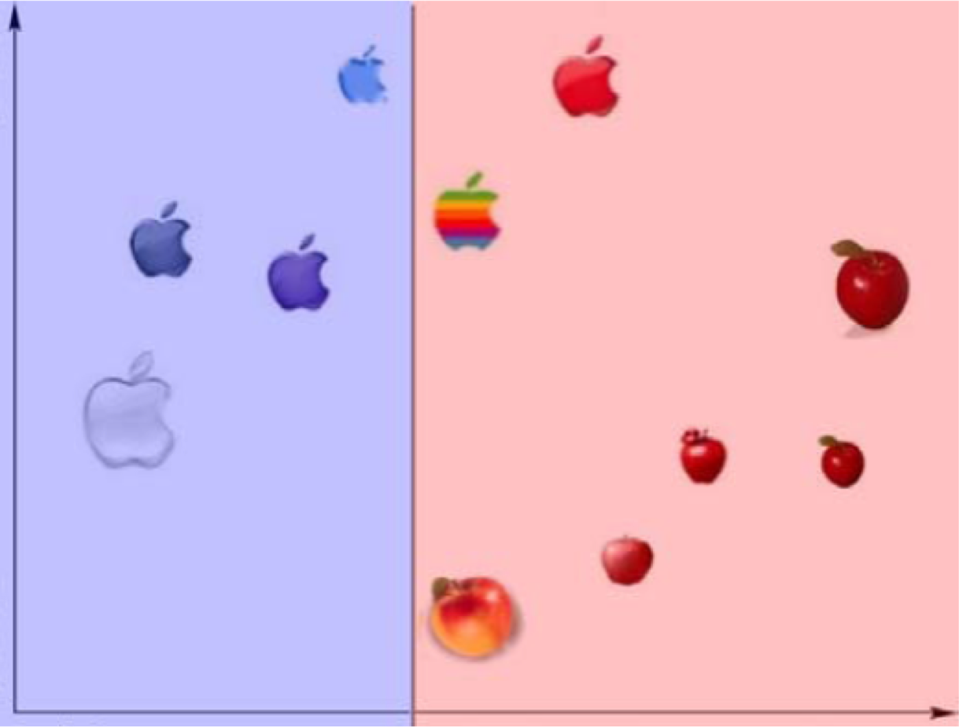
Have many rules (base classifiers) to vote on the decision
Sequentially train base classifiers that corrects mistakes of previous → focus on hard examples
Give higher weight to better rules
4th Rule

Slide 51
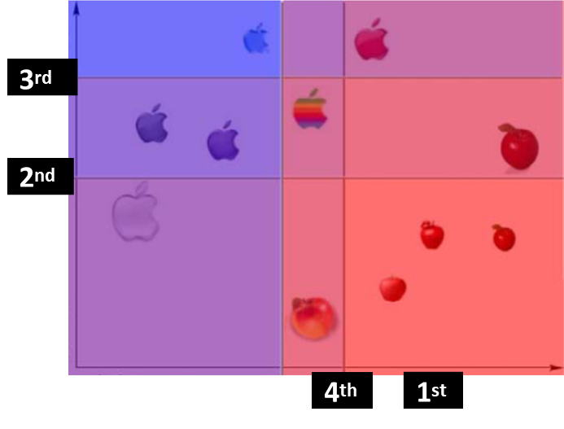
Have many rules (base classifiers) to vote on the decision
Sequentially train base classifiers that corrects mistakes of previous → focus on hard examples
Give higher weight to better rules

Slide 52
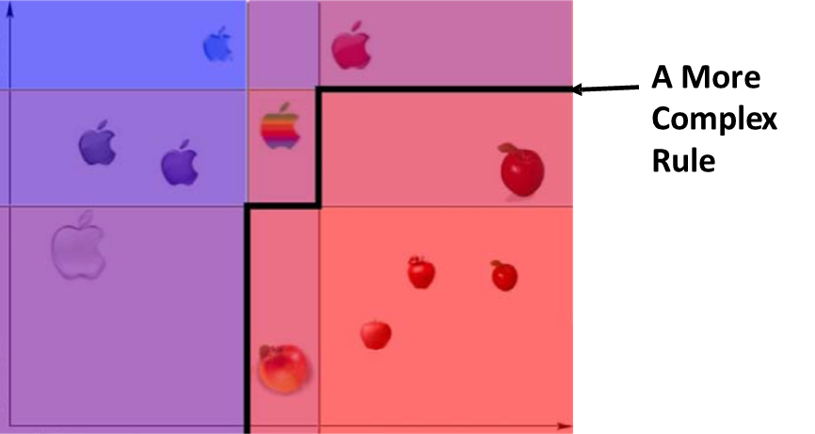
Have many rules (base classifiers) to vote on the decision
Sequentially train base classifiers that corrects mistakes of previous → focus on hard examples
Give higher weight to better rules

Slide 53
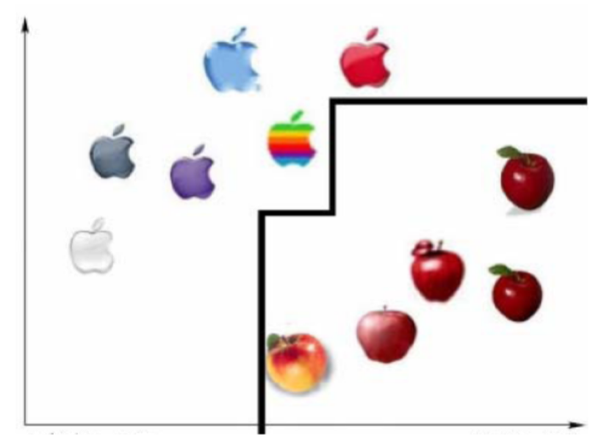
Final Classifier is the additive combination of base rules:

Slide 54
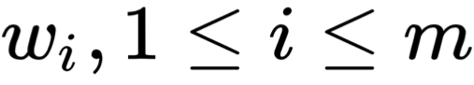
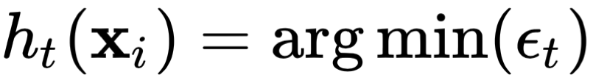
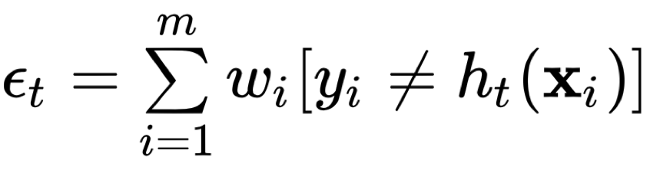
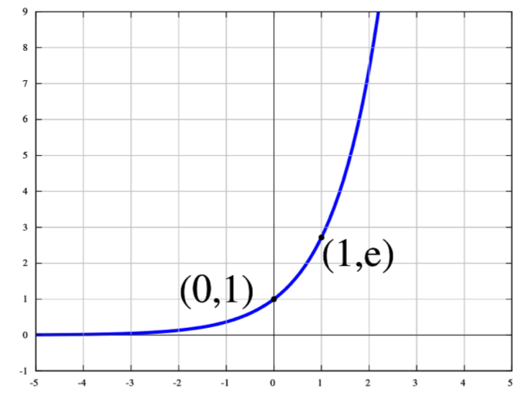
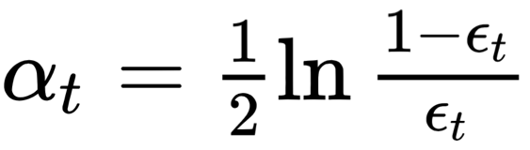
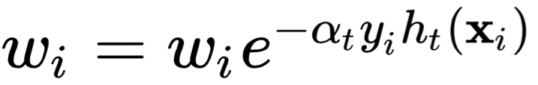
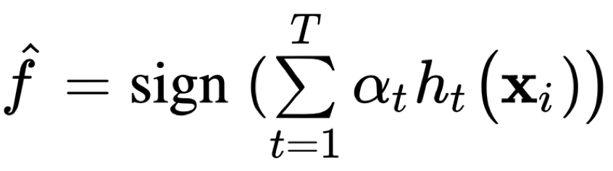
Adaboost Algorithm (Proposed by Robert Schapire)
Training Data:
Set uniform example weight
For t = 1 to T iterations:
Select a base classifier:
Set classifier weight: Update example weight:
Final Classifier:

Slide 55
Boosting vs. Bagging
Similar to bagging, boosting combines a weighted sum of many classifiers, thus it reduces variance.
One key difference: unlike bagging, boosting fit the tree to the entire training set, and adaptively weight the examples.
Boosting tries to do better at each iteration, (by making model a bit more complex),thus it reduces bias.

Slide 56
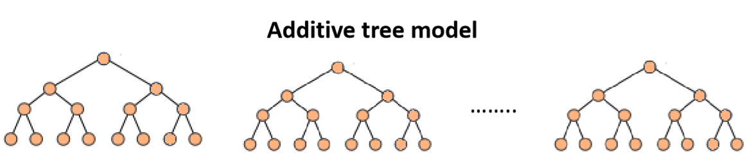
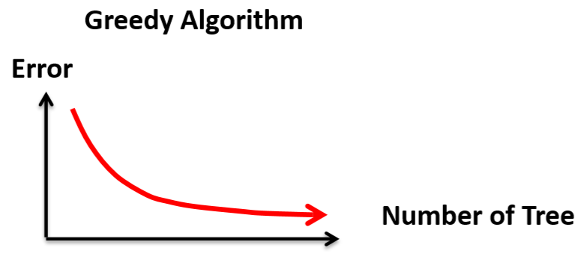
XGBoost
Additive tree model: add new trees that complement the already-built ones
Response is the optimal linear combination of all decision trees
Popular in Kaggle Competitions for efficiency and accuracy

Slide 57
XGBoost
XGBoost is a very efficient Gradient Boosting Decision Tree implementation with some interesting features:
Regularization: Can use L1 or L2 regularization.
Handling sparse data: Incorporates a sparsity-aware split finding algorithm to handle different types of sparsity patterns in the data.
Weighted quantile sketch: Uses distributed weighted quantile sketch algorithm to effectively handle weighted data.
Block structure for parallel learning: Makes use of multiple cores on the CPU, possible because of a block structure in its system design. Block structure enables the data layout to be reused.
Cache awareness: Allocates internal buffers in each thread, where the gradient statistics can be stored.
Out-of-core computing: Optimizes the available disk space and maximizes its usage when handling huge datasets that do not fit into memory.

Slide 58
More about History
Introduction of Adaboost:
Freund; Schapire (1999). "A Short Introduction to Boosting“
Multiclass/Regression
Y. Freund, R. Schapire, “A Decision-Theoretic Generalization of on-Line Learning and an Application to Boosting”, 1995.
Robert E. Schapire and Yoram Singer. Improved boosting algorithms using confidence-rated predictions. In Proceedings of the Eleventh Annual Conference on Computational Learning Theory, pages 80–91, 1998.
Gentle Boost
Schapire, Robert; Singer, Yoram (1999). "Improved Boosting Algorithms Using Confidence-rated Predictions".

Slide 59
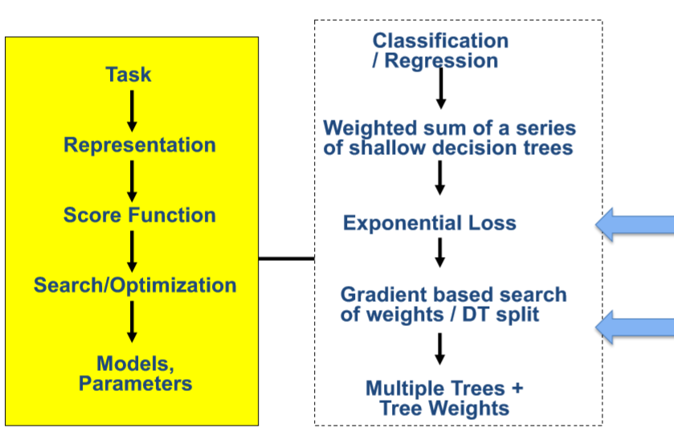
Boosting

Slide 60
References
https://qiyanjun.github.io/2019f-UVA-CS6316-MachineLearning/
Prof. Tan, Steinbach, Kumar’s “Introduction to Data Mining” slide ESLbook : Hastie, Trevor, et al. The elements of statistical learning. Vol. 2. No. 1. New York: Springer, 2009.
Dr. Oznur Tastan’s slides about RF and DT
Dr. Rich’s slides about boosting

Slide 61
Thanks for listening

